Slide 1
Indian Bike Sale Analysis
Key Insights on Price, Fuel, Models & Geography

Slide 2
Objective
Analyse overall bike sales volume and revenue to understand market size.
Compare Original Vs Resale Price to evaluate bike value retention.
Understand the distribution of fuel types (Petrol, Electric, Hybrid) in sales.
Identify Top 10 selling models and states to target high-demand areas effectively.
Understand the distribution of fuel types (Petrol, Electric, Hybrid) in sales.

Slide 3
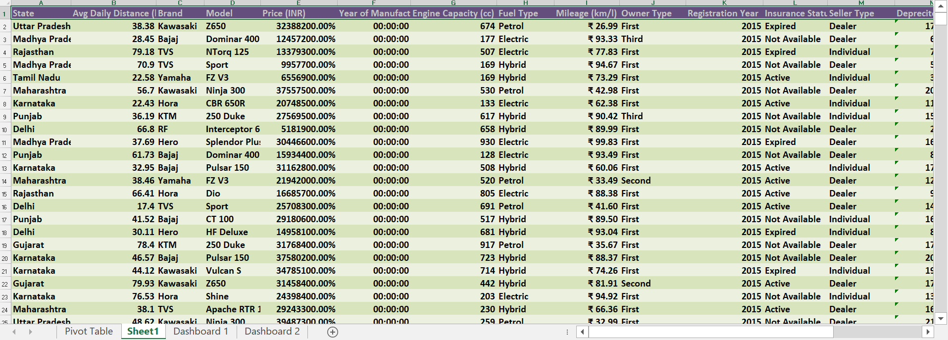
Dataset
Number of rows :10,000
Dataset
From 1jan 2015
Till 31 Dec 2024

Slide 4

Data Pre-processing

Slide 5
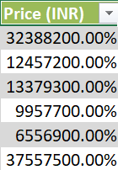
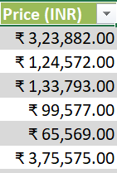
Step and Function are used during Processing
1.Sorting Data by Year
2.Depreciated Value
3.Resale Value
4.Formating Price Column
Sort the Data from oldest to Newest by Year using “Sort & Filter” option in the Data Tab.
Before
After

Slide 6
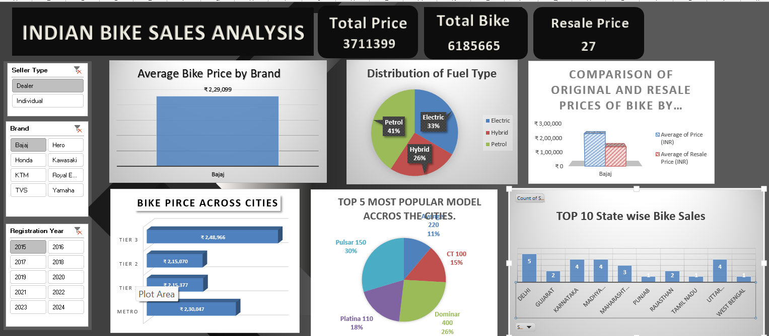
Comparing Vehicle Insights: Sales,Value,Fuel & Performance Metrics Between Individual Sellers and Dealers
For Example
Dealer sell more Bajaj bike in 2015 than individual seller and their prices were lower than those individual dealers

Slide 7
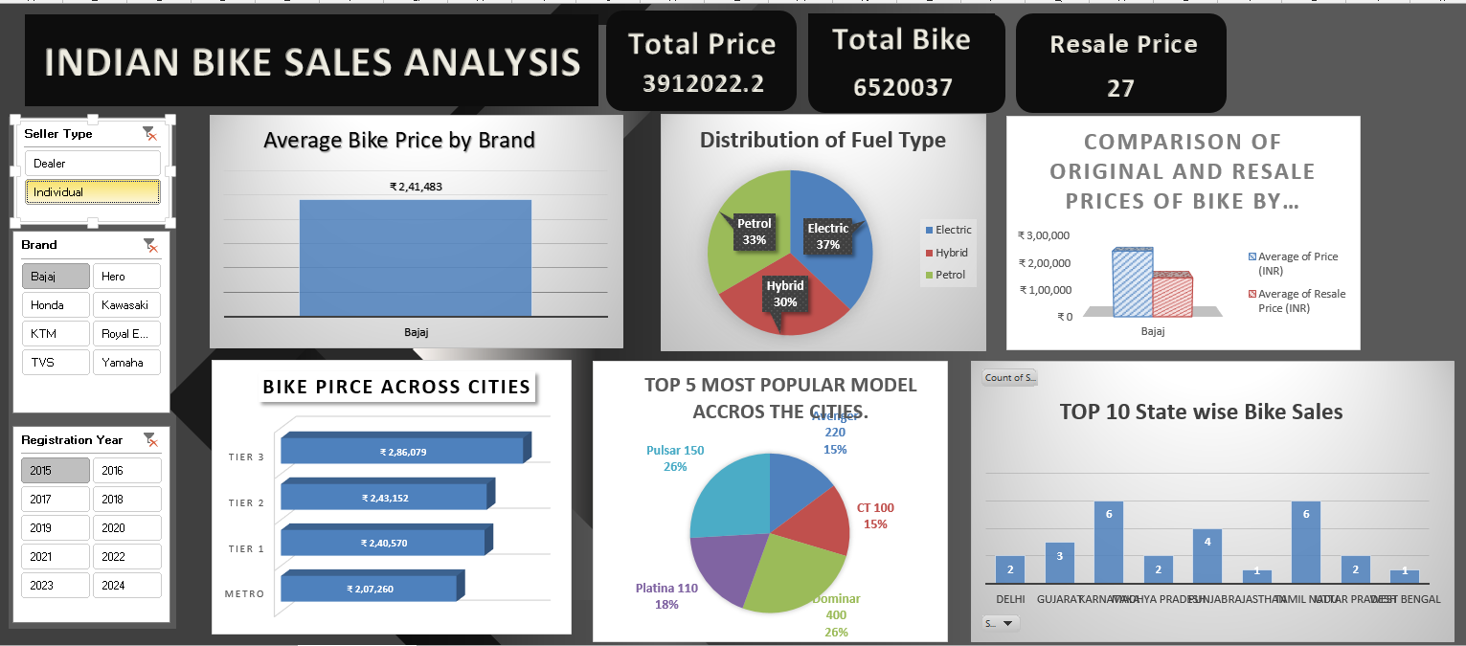
Comparing Vehicle Insights: Sales,Value,Fuel & Performance Metrics Between Individual Sellers and Dealers
For Example ,
In 2015 ,Bajaj bikes sold by Individual sellers were more expensive than those dealers

Slide 8
THANK YOU

